Slide 1

Knowledge Discovery and Management
Tech Champs
Jakkepalli, Rama Charan Pavan (8)
Puthana, Sujitha (24)
Yalamanchili, Sowmya (30)
Nandanamudi, Sreelakshmi (17)

Slide 2
Objective

Slide 3













Dataset
Visualization
Query

Slide 4
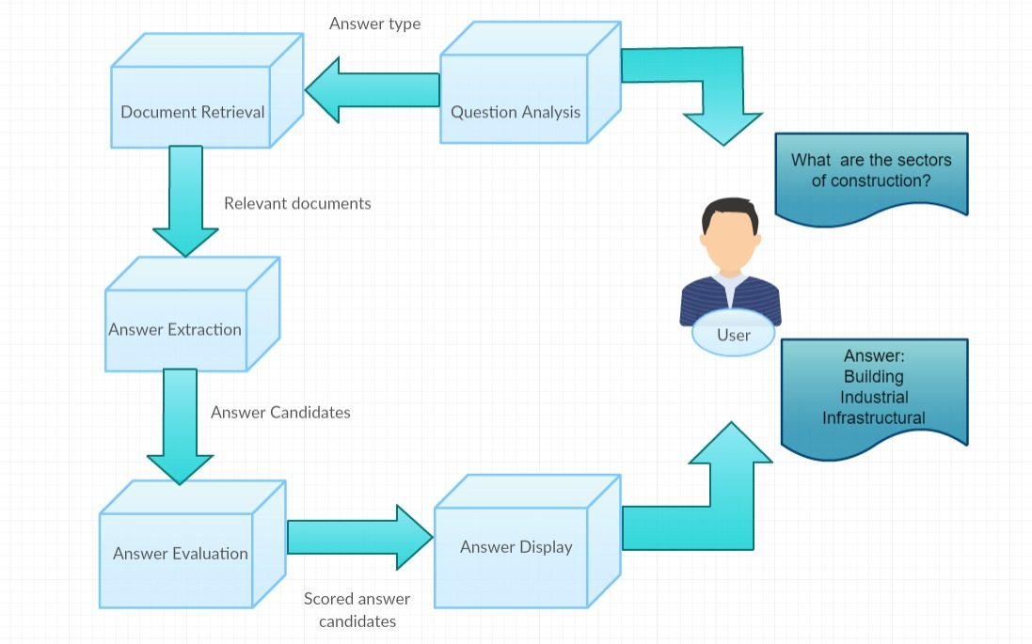
Workflow of Q A System

Slide 5
Thank You

